Slide 1

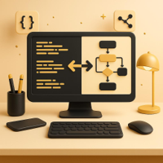
Introduction to Translators: Compilers and Interpreters
Understanding tools for beginner programmers
Notes:
Image source: AI-generated

Slide 2

Agenda
• What Are Translators in Programming?
• Compilers: Turning Source Code Into Executable Programs
• Interpreters: Running Code Step by Step
• Other Translation Tools: Assemblers and Hybrid Approaches
Notes:
What Are Translators in Programming? Compilers: Turning Source Code Into Executable Programs Interpreters: Running Code Step by Step Other Translation Tools: Assemblers and Hybrid Approaches Image source: AI-generated

Slide 3

What Are Translators in Programming?
Notes:
Definition of a Translator, Why Programs Need Translation, Overview of Source Code and Machine Code

Slide 4
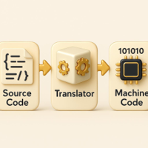
Definition of a Translator
What it is
A software tool that converts high‑level source code into machine‑executable code.
Why it matters
Enables hardware to understand and run programs written by developers.
Common types
Compilers and assemblers—each with distinct roles in development.
Notes:
In programming, a translator is a software tool that converts code written in one programming language into another form, usually converting high-level source code into machine code executable by a computer. This conversion makes programs understandable and executable by hardware. Translators include compilers, interpreters, and assemblers, each serving different but related roles in software development. Image source: AI-generated

Slide 5
Why Programs Need Translation
Complexity of Machine Code
Computers execute binary instructions that are precise but difficult for humans to write and maintain. Machine code exposes low-level details like registers and memory addresses, increasing cognitive load and error risk. Without translation tools, building reliable software would be slow, fragile, and hard to debug.
Readable Source Code Examples
High-level languages let developers express ideas with clear structure, meaningful names, and abstractions. Compilers and interpreters translate this human-friendly code into efficient machine instructions, preserving intent while optimizing execution. This translation enables productivity, portability, and performance.
Notes:
Computers operate at the hardware level using binary machine code, which humans find difficult to write and understand. High-level programming languages are designed for human readability but must be translated into machine-level instructions for a computer to execute tasks. Translation bridges this gap, enabling developers to write in intuitive languages while maintaining machine efficiency.

Slide 6

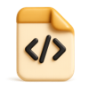

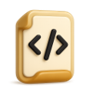

Overview of Source Code and Machine Code
Source Code
Human-readable instructions written in languages like Python or C++. Used by programmers to develop software efficiently.
Machine Code
Binary instructions (0s and 1s) executed directly by the CPU. Not human-readable, hardware-specific.
Example
Source: print('Hello, World!') in Python. Machine: 10111000 00000001... (binary).
Key Attribute
Source code is portable and easy to modify; machine code is fast and hardware-dependent.
Notes:
Source code is the human-readable set of instructions written in high-level programming languages such as Python or C++, while machine code is a low-level set of binary instructions understood directly by a computer’s CPU. Source code allows programmers to develop software efficiently, but only machine code can be executed directly by hardware. Translators perform the essential function of converting source code to machine code to produce functional programs. Image source: AI-generated

Slide 7
Compilers: Turning Source Code Into Executable Programs
Notes:
How a Compiler Works in Simple Terms, Examples of Compiled Languages (C++, C), Advantages and Limitations of Compilers

Slide 8
How a Compiler Works
Translates source code to machine code before execution for speed
Lexical Analysis
Breaks source code into tokens (words, symbols).
Syntax Analysis
Checks code structure for grammatical correctness.
Semantic Analysis
Ensures code makes logical sense and follows rules.
Optimization
Improves code efficiency and performance.
Code Generation
Converts optimized code into machine code.
Executable Output
Produces an executable file ready for running.
Notes:
A compiler translates the entire source code of a program into machine code before execution, generating an executable file. This process involves lexical analysis, syntax analysis, semantic analysis, optimization, and code generation. By doing this upfront, compiled programs typically run faster because no translation occurs during execution.

Slide 9
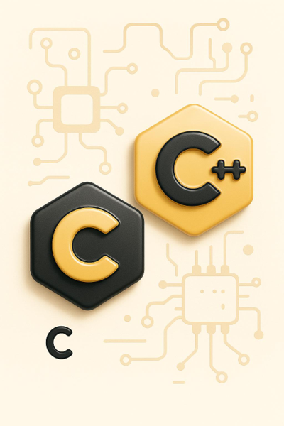
Compiled Languages: C and C++
1
C — Systems-level control and portability
Used for operating systems and embedded kernels; compiles to fast machine code tailored to hardware.
2
C++ — Performance with abstraction
Powers games and high-performance apps; templates and RAII enable efficiency without sacrificing control.
Notes:
Languages like C and C++ use compilers to convert their source code into highly efficient machine code. These compiled languages are often used in performance-critical systems such as operating systems, embedded systems, and games. Their compilation process produces executables optimized for specific hardware, contributing to their widespread use where speed is paramount. Image source: AI-generated

Slide 10
Advantages and Limitations of Compilers
Strengths
Faster program execution, early error detection, optimized machine code generation.
Weaknesses
Longer development cycles, less flexibility for runtime changes.
Opportunities
Integration with advanced optimization tools, adoption in performance‑critical applications.
Threats
Emergence of more flexible interpreters, rising demand for rapid prototyping environments.
Notes:
Advantages of compilers include faster execution speed, early detection of errors during compilation, and optimized machine code. Limitations involve longer development cycles due to compile times and less flexibility for dynamic code changes at runtime. Understanding these trade-offs helps programmers choose appropriate tools based on project needs.

Slide 11
Interpreters: Running Code Step by Step
Notes:
How Interpreters Operate, Examples of Interpreted Languages (Python, JavaScript), Advantages and Limitations of Interpreters

Slide 12
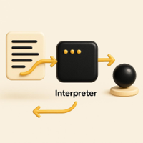
How Interpreters Operate
Runtime, Line-by-Line Execution
Interpreters read and execute source statements sequentially at runtime—no separate executable is produced.
Benefits for Development
Quick testing and easy edits enable rapid iteration and streamlined debugging.
Performance Trade‑off
On‑the‑fly translation often runs slower than compiled programs.
Notes:
Interpreters execute source code line-by-line or statement-by-statement at runtime without producing a separate machine code executable. This allows programmers to test and modify code quickly, supporting rapid development and debugging. However, because translation happens on the fly, interpreted programs often run slower than compiled counterparts. Image source: AI-generated

Slide 13

Examples of Interpreted Languages
Python
Widely used for web apps, scripting, data work, and rapid prototyping in interactive interpreters.
JavaScript
The web’s ubiquitous runtime language, enabling dynamic pages, scripting, and cross-platform development.
Why Interpreters Matter
They power fast feedback loops, portability, and beginner-friendly workflows that scale to production.
Notes:
Python and JavaScript are prominent interpreted languages widely used for web development, scripting, and rapid prototyping. Their interpreters facilitate interactive coding environments and cross-platform compatibility. The flexibility and ease of use offered by interpreters contribute to their popularity among beginner and professional programmers alike. Image source: AI-generated

Slide 14




Advantages and Limitations of Interpreters
Immediate Execution
Code runs instantly without compilation, boosting productivity and enabling rapid prototyping.
Dynamic Typing
Supports flexible data types and runtime changes, making debugging and experimentation easier.
Slower Performance
Interpreted code often runs slower than compiled code due to real-time translation and execution.
Deployment Overhead
Requires interpreter runtime environment, which can complicate deployment and increase resource usage.
Notes:
Interpreters enable immediate code execution and dynamic typing features, enhancing developer productivity and simplifying debugging. On the downside, they typically yield slower program performance and rely on the presence of the interpreter runtime environment, which can add overhead and complexity in deployment scenarios. Image source: AI-generated

Slide 15
Other Translation Tools: Transpilers, Assemblers and Hybrid Approaches
Notes:
What Is an Assembler?, Introduction to Virtual Machines and Bytecode, Brief Mention of JIT (Just-In-Time) Compilation

Slide 16
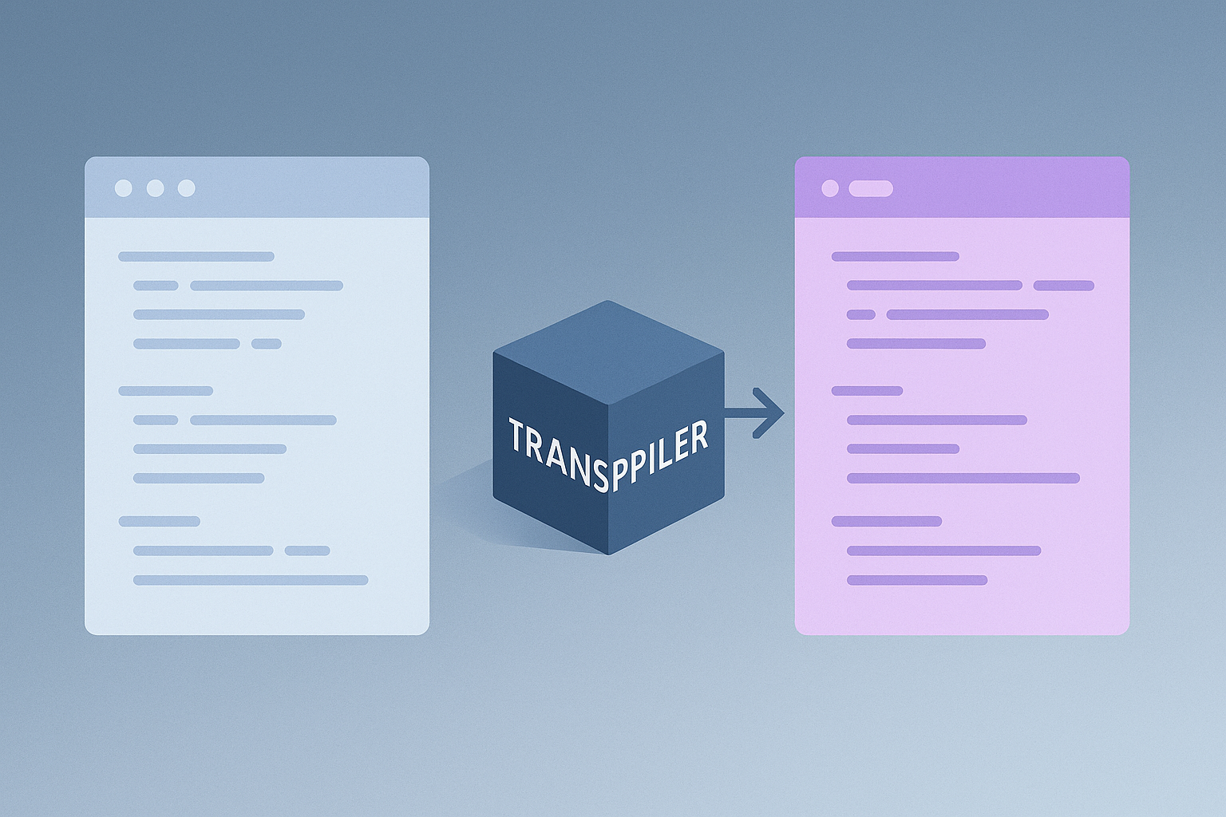
What Is a Transpiler?
Definition
A transpiler converts one language into another.
Where It’s Essential
As an intermediate step when building new compilers, as well as languages that don’t stand on their own. Typescript is a good example. It is transpiled to Javascript.
Notes:
An assembler converts assembly language, a low-level human-readable language closely tied to machine instructions, into binary machine code. Assembly provides control over hardware resources and performance tuning. Assemblers act as translators specialized for this domain and are essential tools in systems programming and embedded device development. Image source: AI-generated

Slide 17
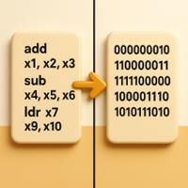
What Is an Assembler?
Definition
An assembler translates human-readable assembly into binary machine code.
Control and Performance
Assembly exposes hardware resources for precise tuning and efficient execution.
Where It’s Essential
Core tools in systems programming and embedded device development.
Notes:
An assembler converts assembly language, a low-level human-readable language closely tied to machine instructions, into binary machine code. Assembly provides control over hardware resources and performance tuning. Assemblers act as translators specialized for this domain and are essential tools in systems programming and embedded device development. Image source: AI-generated

Slide 18
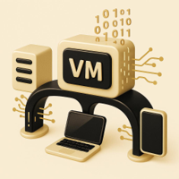
Introduction to Virtual Machines and Bytecode
Bytecode Basics
Compiled into a platform-independent intermediate form, bytecode balances compilation speed with runtime flexibility.
VM Execution Model
Virtual machines interpret or JIT-compile bytecode, delivering portability across diverse hardware.
Example: JVM
Java programs run anywhere a JVM exists, illustrating true cross-platform compatibility.
Notes:
Virtual machines (VMs) execute platform-independent bytecode, an intermediate representation produced by compilers, enabling code portability across diverse hardware. Bytecode balances between compilation and interpretation, improving performance and flexibility. Examples include the Java Virtual Machine (JVM), which allows Java programs to run on any device with the JVM installed. Image source: AI-generated

Slide 19
2-10x
Typical speedup over pure interpretation in Java and C#
Notes:
Just-In-Time compilation combines aspects of both compiling and interpreting by compiling bytecode into machine code at runtime. This approach enhances performance by generating optimized machine code on the fly. Languages like Java and C# commonly use JIT to improve execution speed while maintaining platform independence.

Slide 20
Conclusion: Translators Empower Programming
In summary, translators such as compilers, interpreters, assemblers, and hybrid tools play a vital role in converting human-readable code into executable programs. Understanding these tools helps beginner programmers grasp how their code runs and the trade-offs involved in different translation methods. This foundation is essential for effective programming and software development.
Notes:
In summary, translators such as compilers, interpreters, assemblers, and hybrid tools play a vital role in converting human-readable code into executable programs. Understanding these tools helps beginner programmers grasp how their code runs and the trade-offs involved in different translation methods. This foundation is essential for effective programming and software development.

